Slide 1


DSO570
Class Scheduling Project
Gyan Prakash
Irem Kahyaoglu
Ruhan Dong
Modan (Eileen) Wang
Alex Chang

Slide 2

Introduction
Objective
To apply optimization techniques to improve the current class scheduling system at USC Marshall School.
Problem Description
- Allocations done manually based on historical data
- Little transparency, lack of preference inclusion
- Last minute scrambling for scheduling (only 40%
completed at Phase I)
Solution: An automated system for Hal/Shannon to optimize, which carries out the scheduling task seamlessly and provides an option of taking extraneous factors into account with relative ease.
Notes:
The primary purpose of this project is to apply optimization techniques to improve the current class scheduling system at USC Marshall School of Business.
The current scheduling system offers a lot of opportunities for improvement as the allocations are done manually based on historical data. Moreover, there is no provision to systematically include the preferences of stakeholders into account. Because of all this, there is little transparency in the system and different stakeholders are treated differently.
Additionally, the scheduling of course-sections by the end of Phase I stands at a meager 40% leading to a lot of last minute scrambling for scheduling the remaining courses. Phase II makes manual intervention even harder as it becomes increasingly complex to accommodate special requests with an ever-decreasing number of available time-slots. In many cases, classrooms are not assigned even after registrations get completed.
Such systemic inefficiencies make a very strong case for an automated system which can not only carry out the scheduling task seamlessly but also provide an option of taking extraneous factors into account with relative ease.

Slide 3
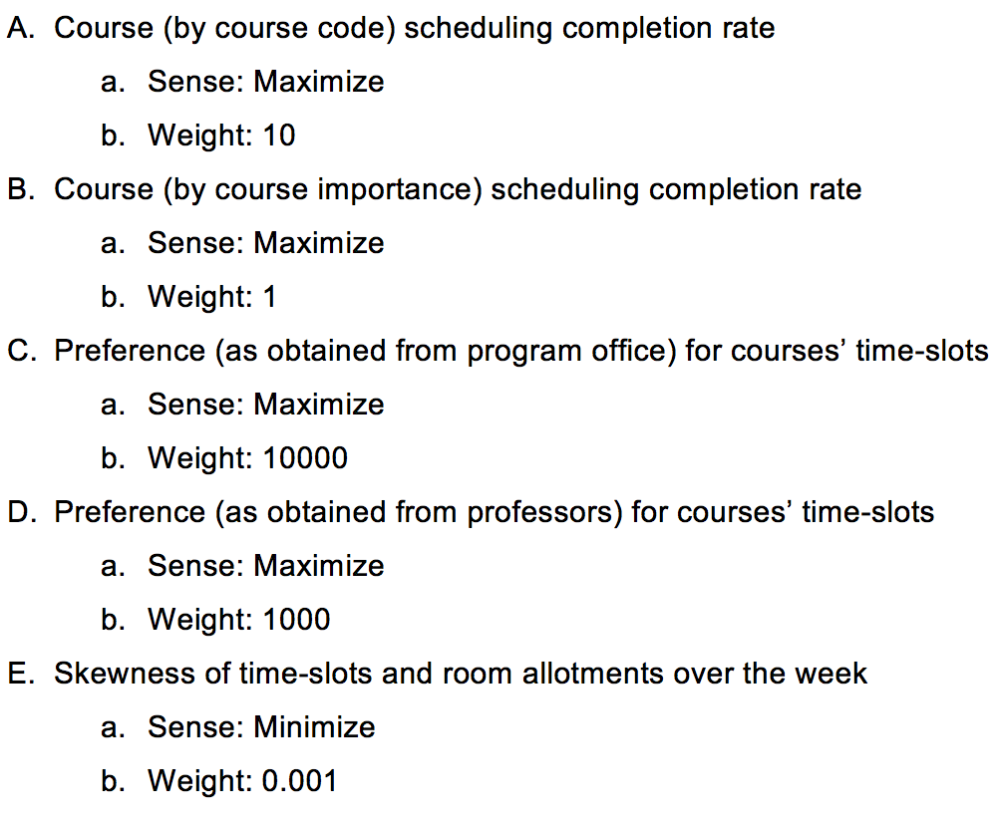
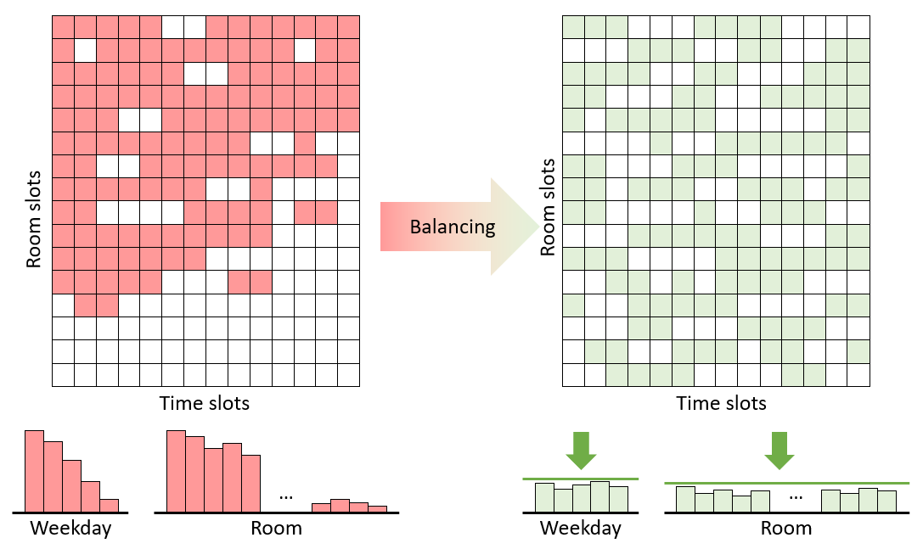
Objective
We defined 5 different objectives with appropriate weights for the final objective function
The final objective function, in terms of A, B, C, D and E:
Maximize(10 x A + B + 10000 x C + 1000 x D + 0.001 x E)
Notes:
We defined five different objectives which were assigned appropriate weights to synthesize the final objective function.

Slide 4
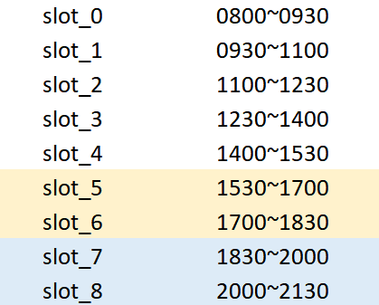
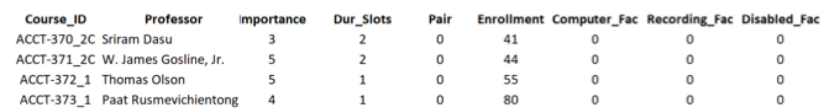
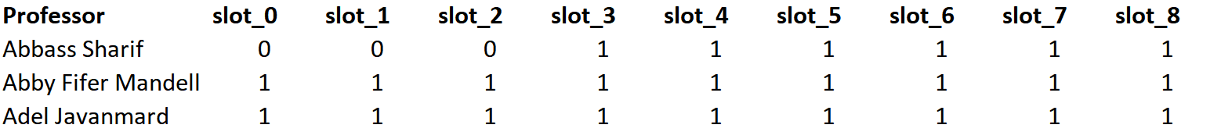
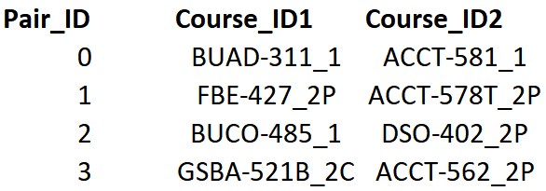
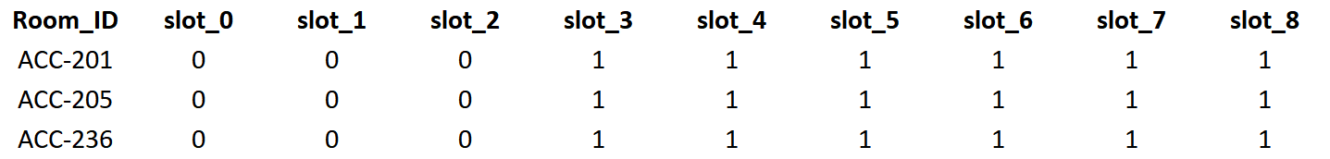
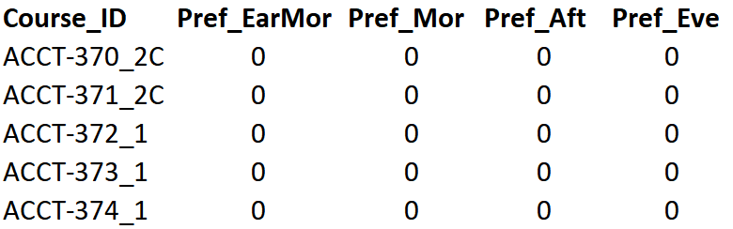
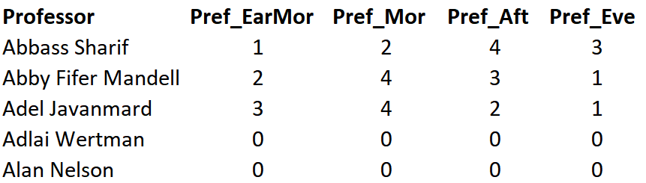
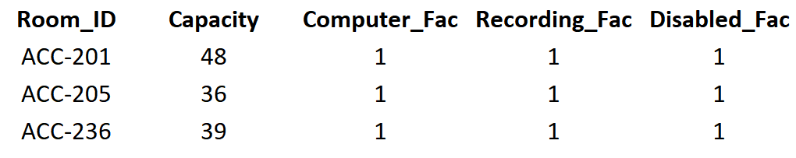
Data Description
3D decision variables as inputs, binary
Each identifies with a given course, classroom and time-slot
Time-slots for different classes
Course-section related information
Professor’s availability
Courses with non-conflicting time-slots
Classroom availability
Preference scores of time-slots and professors
Classroom properties
Notes:
Before they can optimize the model, they’ll need the following inputs. We made reasonable assumptions along the way to account for unforeseen circumstances as accurately as possible.
Time-slots for different classes – We assigned a unique slot ID to each time-slot in a given week. Thus, each weekday was assigned 9 slots (refer to Exhibit 1) such that a given week had a total of 45 time-slots. As per the current practice, we assumed that consecutive 1.5-hour slots for a 3-unit course can only be assigned at 3:30 pm (till 6:30 pm) and 6:30 pm (till 9:30 pm). A typical day looks like the illustration given below. It is to be noted that 3-hour slots are exclusively assigned to the highlighted time-slots although they can also be used for 1.5-hour slots.
Classroom properties – Every classroom should have information about its capacity, whether computing facilities are available, whether recording facilities are available and whether it is ADA (Americans with Disabilities Act) compliant.
Course-section related information – Every course-section should have information about the professor teaching it, importance (as designated by the respective program office) on a scale of 1 to 5, whether consecutive slots should be assigned (i.e., one 3-hour class for a 3-unit course as opposed to two 1.5-hour classes), enrollment, and whether other facilities are required.
Classroom availability – All rooms may not be available for course-section slot allocation all the time. So, it is important that the model is fed only those slots that it can allocated course-sections to.
Professor’s availability – To account for the fact that certain professors might be unwilling to teach during certain time-slots, we included an input to that effect.
Courses with non-conflicting time-slots – There are always certain courses which should not be allowed have time-slot conflict because either they are core courses or very popular electives.
Preference scores of time-slots for course-sections and professors – Depending on feedback from students and/or other stakeholders, different course-sections can be assigned different preferences.

Slide 5
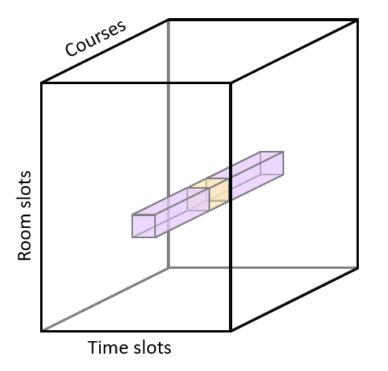
Constraints
Took into account 10 constraints
One course-section → a given time-slot in a given classroom.
Each 1.5-unit course-section: at most 1 time-slot.
Each 3-unit course-sections: 2 time-slots.
Two time-slots taken by 3-unit course-sections shouldn’t coincide.
Two time-slots taken by 3-unit course-sections: in the same room
Two consecutive 3-unit course-sections: at 3:30p (till 6:30p) or 6:30p (till 9:30p)
Two non-consecutive 3-unit course-sections: two slots are on Mon-Wed or Tue-Thu.
Unavailable classrooms shouldn’t be assigned for time-slots
Incompatible classrooms shouldn’t be assigned
Courses shouldn’t be assigned to unavailable classrooms.

Slide 6
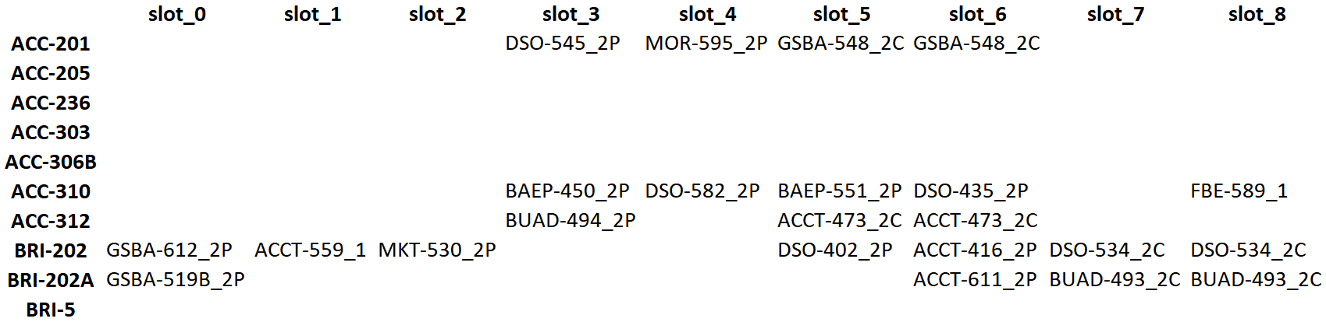
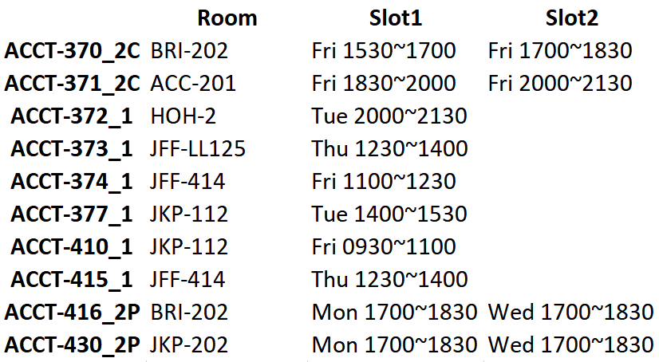
Model Output
The contains performance metrics, time-slot allocation table by classroom and by course-section.
The time-slot allocation table for Monday for first 10 classrooms:
Lists of the times of the day and
days of the week that a
given course is scheduled.
Notes:
The output of the model contains performance metrics, time-slot allocation table by classroom and by course-section.

Slide 7
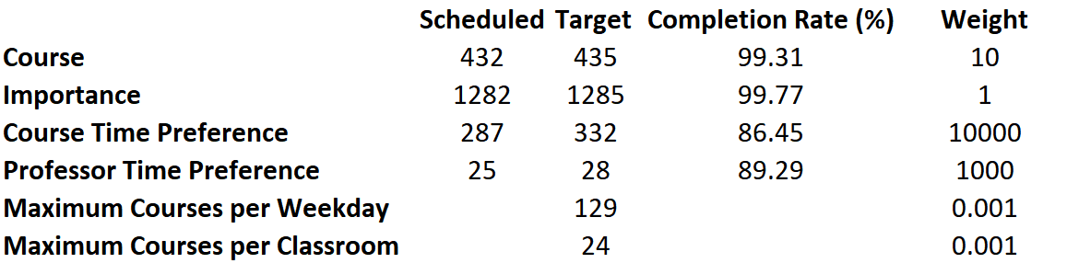
Model Output
Performance Metrics
The optimized model achieved 100% completion rate by both course code and course importance.
Notes:
While devising the model, we carefully calibrated our formulations such that they are not just easily computable but also actionable, simple and enlightening. We used the following metrics for evaluating the performance of our model.
Course (by course code) scheduling completion rate
Course (by course importance) scheduling completion rate
Preference (as obtained from program office) for courses’ time-slots
Preference (as obtained from professors) for courses’ time-slots
Skewness of time-slots and room allotments over the week

Slide 8

Assumptions
We included information as to whether classrooms have or course-sections need computing and recording facilities and whether they are ADA compliant.
We scaled the importance of courses from 1 to 5
Added stakeholder preferences
We blocked certain time-slots for certain classes to reflect that not all classrooms or professors might be available all the time
Certain courses shouldn’t have time conflicts:
Keeping the best interests of students in mind,
keeping certain core courses and popular elective
from clashing serves them well.
This is expected to cut down the time spent on
tending to special requests.
Notes:
We included information as to whether classrooms have computing and recording facilities and whether they are ADA compliant. Anticipating the requirements of different courses and/or students, we included the same information per course-section. Besides, we also inserted a variable representing the importance of courses on a scale of 1 to 5. This order is intended for the respective program offices to obtain, hopefully with inputs from students. Not just that, program offices can also provide the time of the day they would prefer for certain course-sections and students as stakeholders, can play a major role in deciding this in conjunction with their respective program offices.
To reflect the fact that not all classrooms might be available for slot allocation all the time, we blocked certain time-slots for certain classes such that no course-sections could be allocated to those slots. Similarly, professors may be unable to teach during certain time-slots due to personal and/or professional commitments and we fed that information into our model by making certain time-slots for certain professors unavailable. We also took professors’ convenience into account by inculcating information as to which time of the day they prefer to teach.
We also considered the fact that certain courses shouldn’t have time conflicts. Keeping the best interests of students in mind is important and keeping certain core courses and popular elective from clashing serves them well. We believe that feeding such data into the model beforehand is expected to cut down the time spent on tending to special requests.

Slide 9
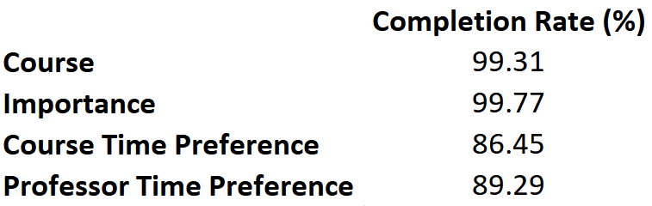
Conclusion
Based on the metrics for performance measurement, our model was able to allocate time-slots for all but 0.7% of the course-sections under all constraints. This is a 2.5-fold improvement over the existing Phase I allocation rate.
We hope that our model will bring down the workload of Hal and Shannon. We would encourage gathering more preference data from stakeholders to minimize the work required for later phases.
Note: The weights can be adjusted depending on how much importance Hal and Shannon decide to assign to each of the components.
Notes:
Based on the metrics we devised to measure the performance of our optimization model, it can be seen from the exhibit given below that model was able to allocate time-slots for all but 0.7% of the course-sections under all constraints. This is a 2.5- It is worth noting at this point that the above results were obtained using the weights assigned to different component objectives as discussed earlier in this text. We chose weights that we thought would result in achieving higher allocation rate. However, they can be adjusted depending on how much importance Hal and Shannon decide to assign to each of the components. As an illustration, we have shown below how changing the weights affects the performance metrics of the model.

Slide 10
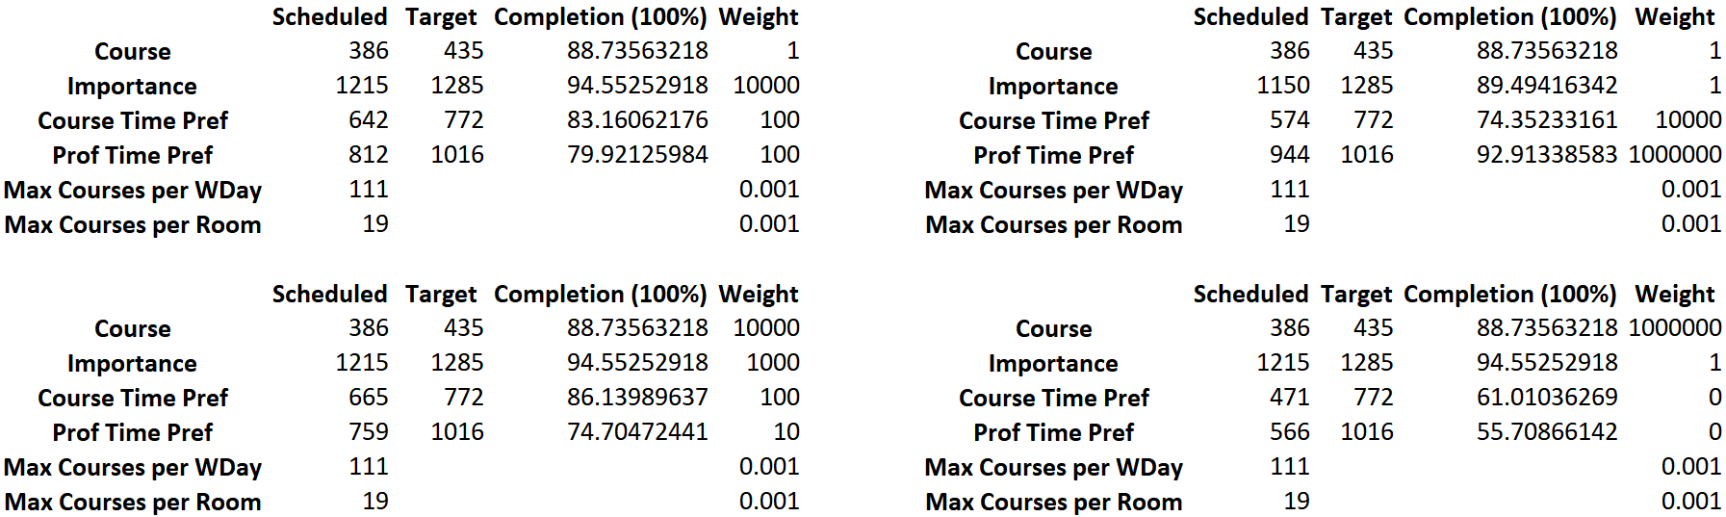
Recommendations
We present a very customizable optimization model which not only accounts for different possible scenarios but also prioritizes the convenience of different stakeholders.
In the absence of course importance and preference scores, those values can be populated with 0s. Such agility makes our model very portable and transferable.
It can be adapted by a different school or repurposed.
Notes:
We present a very customizable optimization model which not only accounts for different possible scenarios but also prioritizes the convenience of different stakeholders. While we decided to feed our model with additional inputs such as course importance and preference scores to pave the way for a more feedback-based scheduling system, it is worth noting that in absence of such data those values can be populated with 0s and the model would work just fine. Such agility makes our model very portable and transferable. It can very easily be adapted by a different school, say USC School of Cinematic Arts, with minimal changes. It can also be repurposed with relative ease for other scheduling tasks at USC Marshall.
Having said that, we hope that our model will help bring down the workload of Hal and Shannon. We would like to encourage them to gather as much preference data from different stakeholders as possible so that minimal work is required in later phases. Putting up efforts for collection of such data is a one-time investment and small incremental changes yearly will be sufficient to sustain optimal allocation in the years to come.

Slide 11
Limitations & Future Scope
Needs manual intervention to accommodate special requests, unforeseen circumstances, building repairs and other disruptions, etc.
Doesn’t use predictive analytics to account for courses that are likely to be cancelled; more data can help with prediction and adjusting the model
Occupancies and usage rates of classrooms can be improved if the students dropping out of a course is inculcated in the model
Courses corresponding to programs with part-time option can be given evening slots
Since, JFF and JKP, and ACC and BRI are in close, it can be assumed that professors and students wouldn’t mind switching within the two groups of buildings for consecutive classes
Notes:
As with all mathematical models, this model can’t assure perfect slot allocation. There will be need for manual intervention to accommodate special requests, unforeseen circumstances, building repairs and other disruptions, etc. It also doesn’t use predictive analytics to account for course-sections that are likely to be cancelled. A lot of historical data will be required so that machine learning algorithms can be used to obtain reliable results. The model also doesn’t account for students dropping out from a given course-section. Also, we didn’t use proximity of classrooms from professors’ office in our model, which can well be a factor for many faculty members.
More data will allow us to predict courses that are likely to be cancelled thus, allowing us to adjust our model accordingly. Similarly, if students dropping out of a given course-section is inculcated in the model such that the classroom allocation automatically changes when the number of students in that section drops, it would improve occupancies and usage rates of classrooms. Courses corresponding to programs with part-time option can be given evening slots to enable part-time students to attend them. If such data becomes available, it would strengthen our model.
Besides, there are four major buildings under USC Marshall where most of the classes are held. These are Jane Hoffman Popovich and J. Kristoffer Popovich Hall (JKP), Jill and Frank Fertitta Hall (JFF), Bridge Hall (BRI) and Elaine and Kenneth Leventhal School of Accounting (ACC). Since, JFF and JKP, and ACC and BRI are in close proximity, they can be lumped together into two groups, meaning that it can be assumed that professors and students wouldn’t mind switching within the two groups of buildings for consecutive classes.

